Slide 1
Do strict open carry gun laws reduce gun violence
Milestone 2:
Eric Hardy, David Ingram, Rachel Kitabjian, Bradley Merfeld

Slide 2
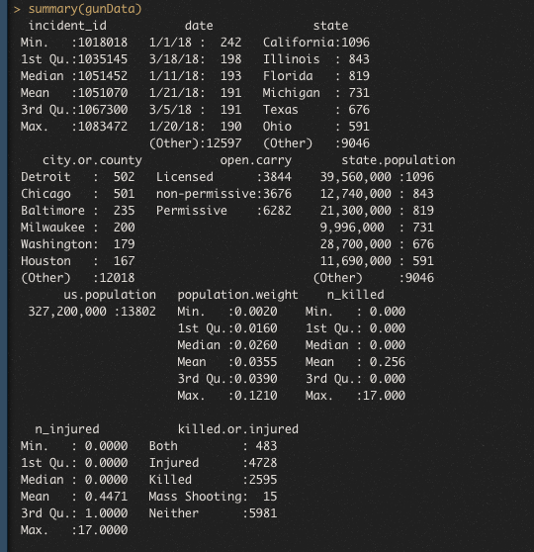
Section 1: Descriptive Statistics
Summary of data included:
Quantity of incidents
Quantity of injured
Number of individuals killed
Guns per capita per state

Slide 3
Creating Exploratory Graphs
We used R programing language
Graphed in ggplot2 package
A part of Tidyverse
Creates more graphs to explore the data visually
Created two graphs
Explored different ways at looking open carry vs. “amount of incidents vs. incident type”

Slide 4
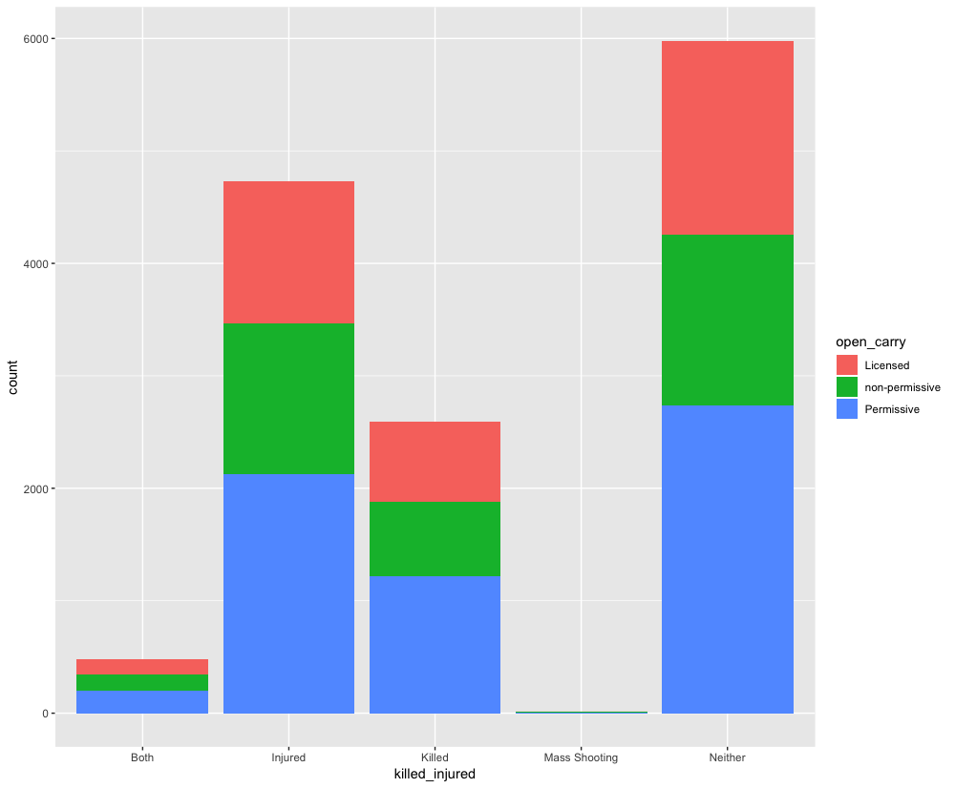

Slide 5
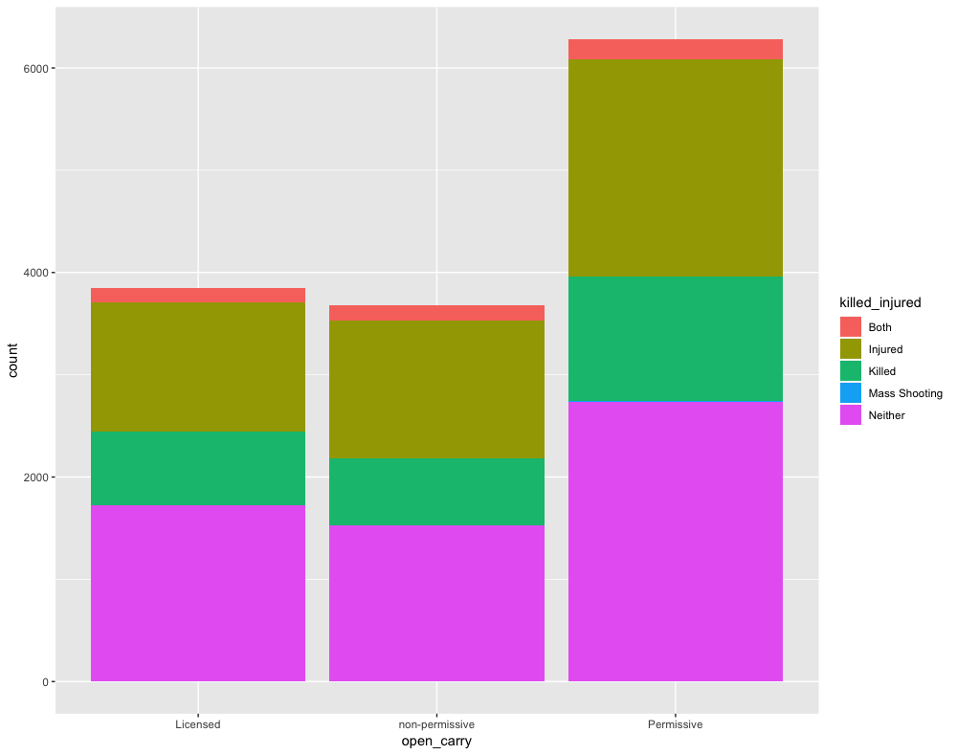

Slide 6
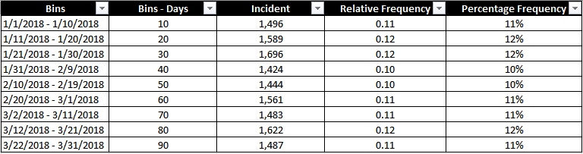
Relative and Percentage Frequency
Since our data set was for the first quarter of 2018 (90 days)
Each bin contain 10 days
Incident rate barely varied from bin-to-bin over the course of the 90 days
Weather became warmer, it did not have an impact

Slide 7
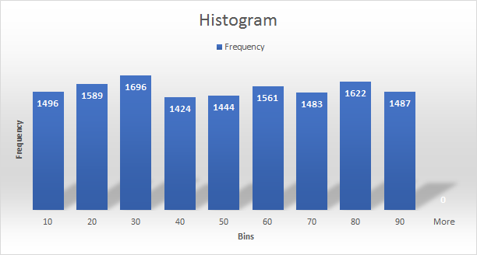
Histogram
Data Analysis
Input Range: Incident
Bin Range: Bins-Days
Skewness could not be identified

Slide 8
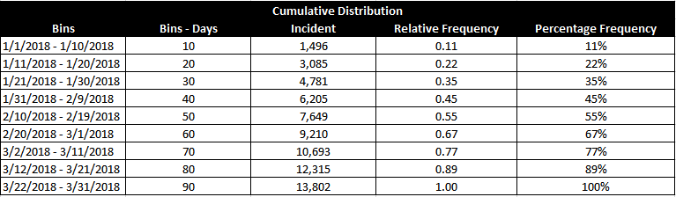
Cumulative Frequency
Supports how the weather did not have an impact

Slide 9
Exploratory Graphs: Per Capita
Analyze the per capita crimes
Created a point graph that shows the following:
Each state
Number of incidents
How many people were killed per capita
How many guns included per crime per capita

Slide 10
Exploratory Graphs: Per Capita (cont.)
A similar graph was produced for injured
Appearance is very similar but has the following difference:
Bigger shapes as circles, that is omitted for brevity

Slide 11
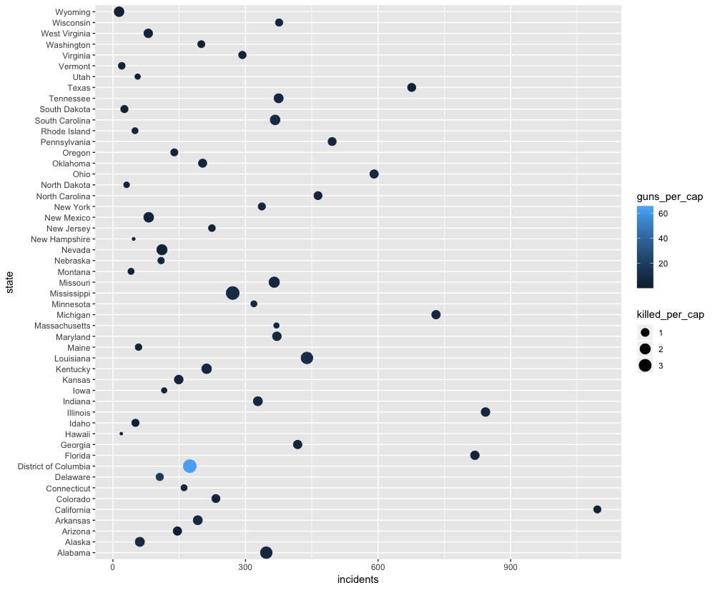

Slide 12
Section 2: Descriptive Data Mining
K Means Clustering:
A data frame was created to represent per capita crimes
Pro: Assisted in understanding data & population size
Con: Categorical data dropped (State, Open Carry)
Association Rules:
All variables included

Slide 13
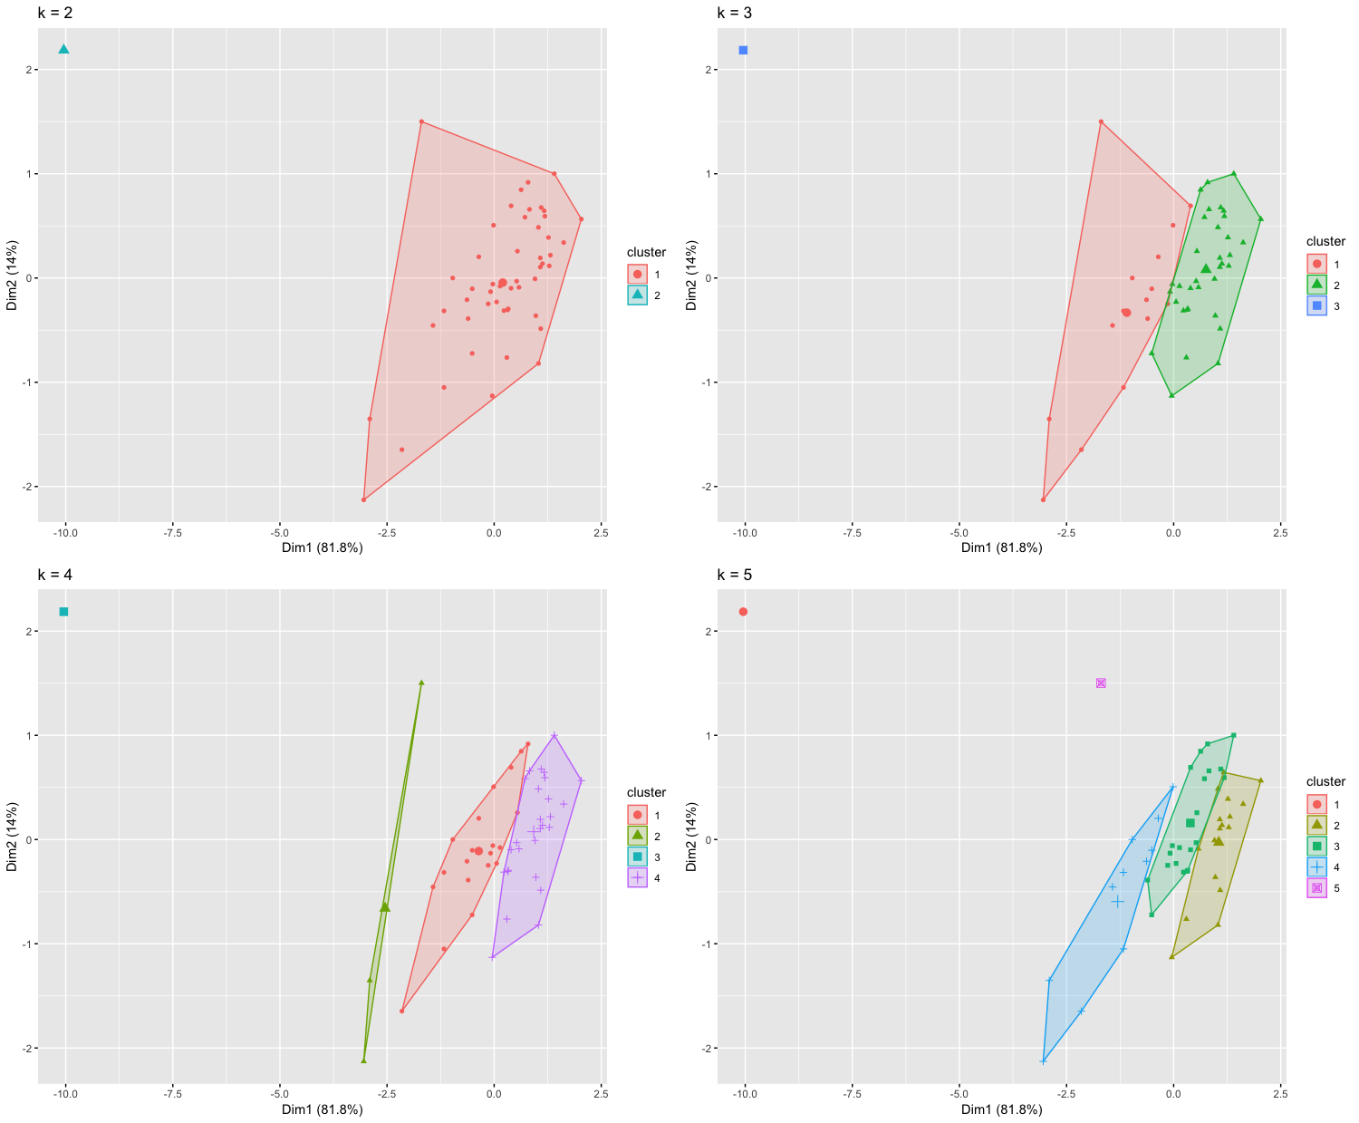
K-Means Clustering
Using R programming language to perform a K means clustering
Packages used:
Tidyverse
Cluster
Factoextra

Slide 14
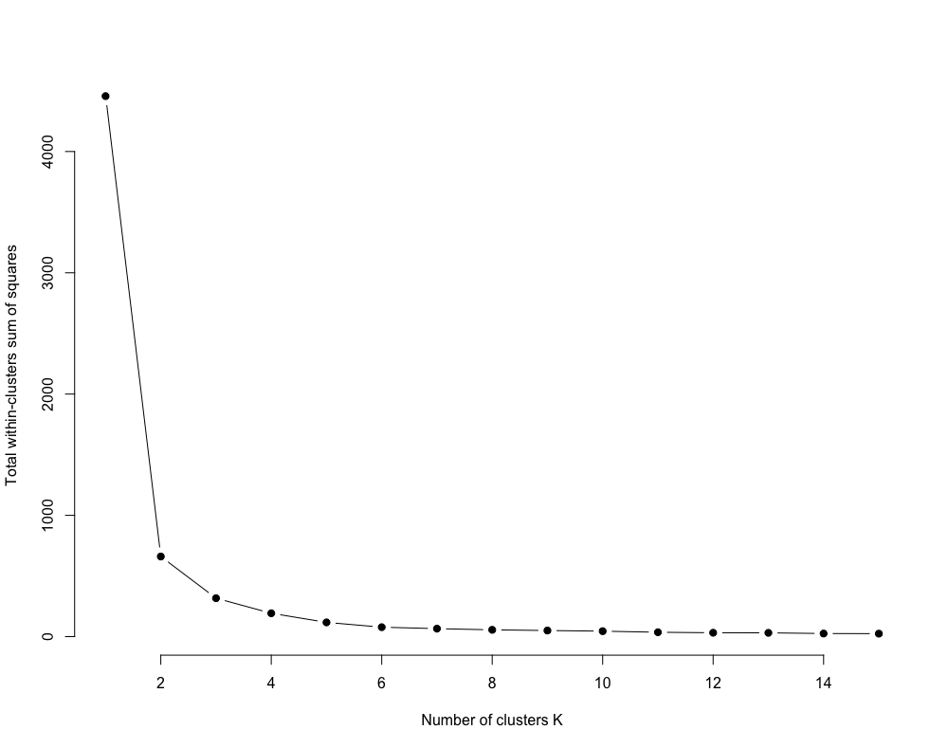
Sum of Squares Elbow Chart
The optimal number of clusters appears to be four

Slide 15
Association Rules
Performed analysis on original data, includes the following variables:
open carry
n_killed
n_injured
Etc.
Used R programming, “arules” package, and an “apriori” argument
Provided us 122 rules
However, using the following:
“rules 20 <- apiori(gun, parameter = list(minlen = 2, maxlen = 3, supp = .3))”
Reduced to 20 rules
Easier to analyze

Slide 16
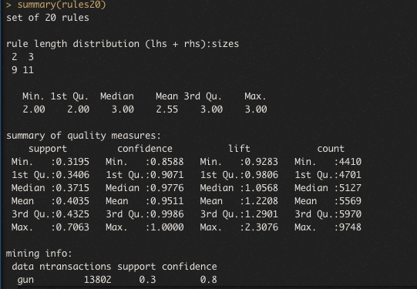
Summary of Association Rules

Slide 17
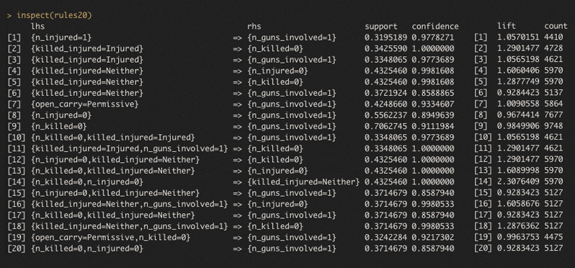
Association Rules Screenshot
The following code created graphs to better analyze our results

Slide 18
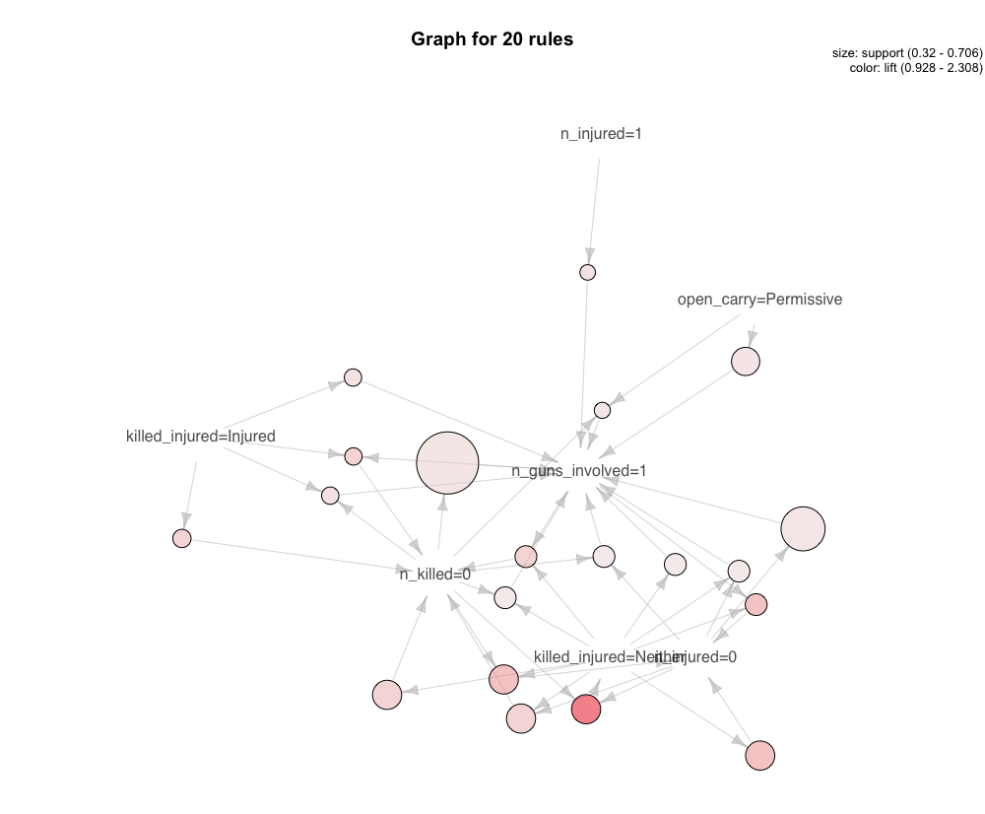

Slide 19
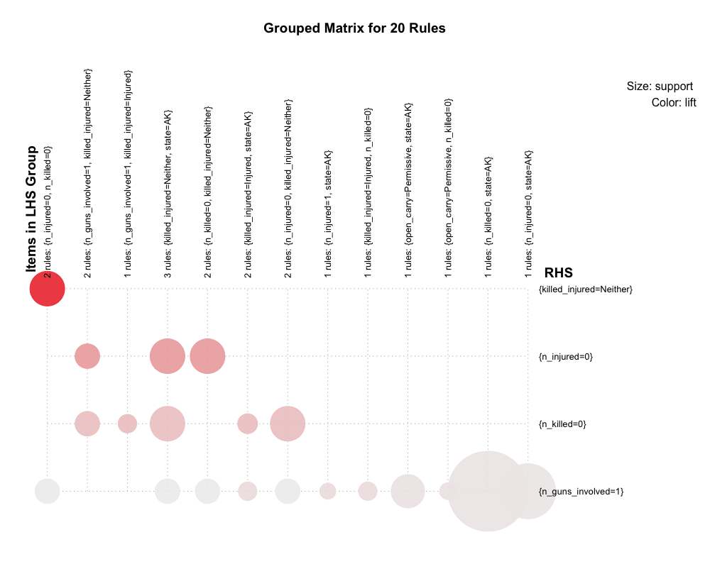

Slide 20
Hypothesis
Previous Hypothesis: States with strict open carry gun laws will have less incidents per capita, killed per capita, injured per capita, and guns involved per capita than states without open carry laws. Therefore, constituting the thought that stricter open carry gun laws violence
Updated Hypothesis: States with non-permissive or licensed open carry gun laws will have less incidents per capita, killed per capita, injured per capita, and guns involved per capita than states without open carry laws

Slide 21
Conclusion
Washington DC is a major outlier
Does not seem conclusive currently that gun laws correlate to open carry laws
Other factors may influence gun crime other than open carry status

